Slide 1
Summer Internship 2026-2027 ML & Edge Computing enabled EMS for optimization of Hybrid Electric Powertrain
Mishael Julian
(Reg No: 2462184)
Duration: 30 days
Under the guidance of
Dr. Sujatha AK
Assistant Professor, Dept of ADSE
Date

Slide 2
Contents
Introduction
Literature Survey
Objectives
Graphical Abstract
Actual Work
Results and Discussion
Conclusion
References
Q & A

Slide 3
Introduction
HEV Powertrain Dynamics: Hybrid Electric Vehicles combine Internal Combustion Engines (ICE), Electric Motors (EM), and high-voltage battery packs to minimize emissions and maximize fuel efficiency.
Supervisory EMS Challenge: The Energy Management System (EMS) determines the real-time torque and power split. Conventional rule-based EMS controllers operate purely reactively based on instantaneous telemetry
The Need for Predictive Control: Reactive controllers cannot anticipate upcoming route topography, traffic congestion, or rapid driver acceleration, leading to suboptimal battery depletion and engine low-efficiency operation.

Slide 4
Literature Survey
Domain 1: HEV Supervisory Control & Optimization: Study of global optimization (Dynamic Programming, Pontryagin's Minimum Principle) versus real-time instantaneous strategies (ECMS and Rule-Based Controllers).
Domain 2: Machine Learning for Time-Series Vehicle Forecasting: Investigation of regression techniques (Random Forest, Gradient Boosting, XGBoost) and rolling-window lag features for predicting short-term speed, acceleration, and power demand.
Domain 3: Context-Aware Telemetry & Route Optimization: Analysis of traffic-density modeling, route segmentation (Urban, Suburb, Highway), and look-ahead State-of-Charge (SOC) planning across standard drive cycles (WLTP, NEDC).

Slide 5
Literature Survey
No | Authors | Year | Title
1 | A. Sciarretta and L. Guzzella | 2007 | Control of Hybrid Electric Vehicles
Key Points |  | Reviews control strategies for Hybrid Electric Vehicles.
Gaps/Scope of future work |  | Conventional EMS approaches primarily depend on available vehicle-state information.
Inheritance |  | Our project builds on conventional HEV control concepts by introducing ML-assisted predictive information for EMS decision-making and energy optimization.
Publisher/Paper/ View |  | IEEE Control Systems Magazine — Research Paper

Slide 6
Literature Survey
No | Authors | Year | Title
2 | I. Husain | 2021 | Electric and Hybrid Vehicles: Design Fundamentals
Key Points |  | Presents fundamental concepts of electric and hybrid vehicle architecture.
Gaps/Scope of future work |  | Primarily focuses on vehicle design and engineering fundamentals.
Inheritance |  | Our project applies these HEV powertrain fundamentals to develop and evaluate a predictive Energy Management System.
Publisher/Paper/ View |  | CRC Press — Technical Textbook

Slide 7
Literature Survey
No | Authors | Year | Title
3 | L. Breiman | 2001 | Random Forests
Key Points |  | Introduces the Random Forest ensemble-learning method.
Gaps/Scope of future work |  | Random Forests do not inherently model long-term temporal behaviour.
Inheritance |  | Our project uses ML-based regression and engineered vehicle-history features to predict future speed, acceleration and power demand for predictive EMS support.
Publisher/Paper/ View |  | Machine Learning — Springer — Research Paper

Slide 8
Literature Survey
No |  | Year | Title
2 | UNECE | 2023 | Worldwide Harmonized Light Vehicles Test Procedure (WLTP)
Key Points |  | Defines standardized testing procedures for light vehicles.
Gaps/Scope of future work |  | Standardized drive cycles cannot represent every real-world driving condition.
Inheritance |  | Our project uses representative driving cycles such as WLTP to simulate vehicle operation and evaluate predictive EMS behaviour and energy-related KPIs.
Publisher/Paper/ View |  | United Nations Economic Commission for Europe (UNECE) — Technical Standard

Slide 9
Objectives
Objective 1: Investigate and formulate the supervisory Energy Management System architecture for hybrid electric powertrains.
Objective 2: Develop and implement a robust data preprocessing pipeline for telemetry, IMU sensor signals, driver behavior, and NASA battery datasets.
Objective 3: Design and train a Machine Learning-assisted Demand Forecaster using lag-based Random Forest regression to predict speed, acceleration, and power demand.
Objective 4: Implement a Hybrid Decision Engine combining predictive ML guidance, traffic/route preview, and deterministic rule-based safety overrides.
Objective 5: Validate the predictive EMS Proof-of-Concept in a modular Python simulation environment across standard drive cycles (WLTP Urban, WLTP Mixed, Bangalore Urban) and benchmark Key Performance Indicators (KPIs).

Slide 10
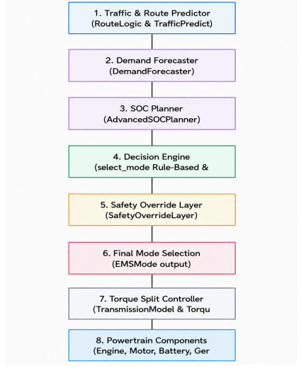
Graphical Abstract
Overall PHEX '27 Project: End-to-end HEV architecture, physical engine/motor models, battery dynamics, CAN-FD communication studies, and baseline rule engine.
My Specific Contribution: Predictive EMS layer: Feature engineering pipeline, Random Forest Demand Forecaster (Speed, Accel, Power), Hybrid Decision Engine, and Drive-Cycle KPI validation.
Multi-Layer Flow: Telemetry Data Ingestion -> Lag Preprocessing -> Demand Forecaster -> Hybrid Decision Engine -> Safety Layer -> Powertrain Actuation.

Slide 11

Proposed Methodology
1. Telemetry Preprocessing Pipeline: Handled duplicate records, imputed missing values, applied IQR outlier clipping, standardized continuous variables, and derived IMU jerk and battery health features.
2. Tractive Power Physics Formulation: Calculated total tractive force: F_traction = F_rolling + F_aero + F_grade + F_acceleration, and corresponding instantaneous power demand: P_demand = F_traction * v.
3. Lag-Based Demand Forecasting: Constructed rolling-window lag features (t-1, t-2, t-3); trained 3 independent Random Forest Regressors using trip-level data partitioning to prevent temporal leakage.
4. Hybrid Decision Engine Logic: Combined ML advisory mode recommendations with deterministic supervisory rules (regenerative priority, high-power boost, urban EV priority, and safety overrides).

Slide 12
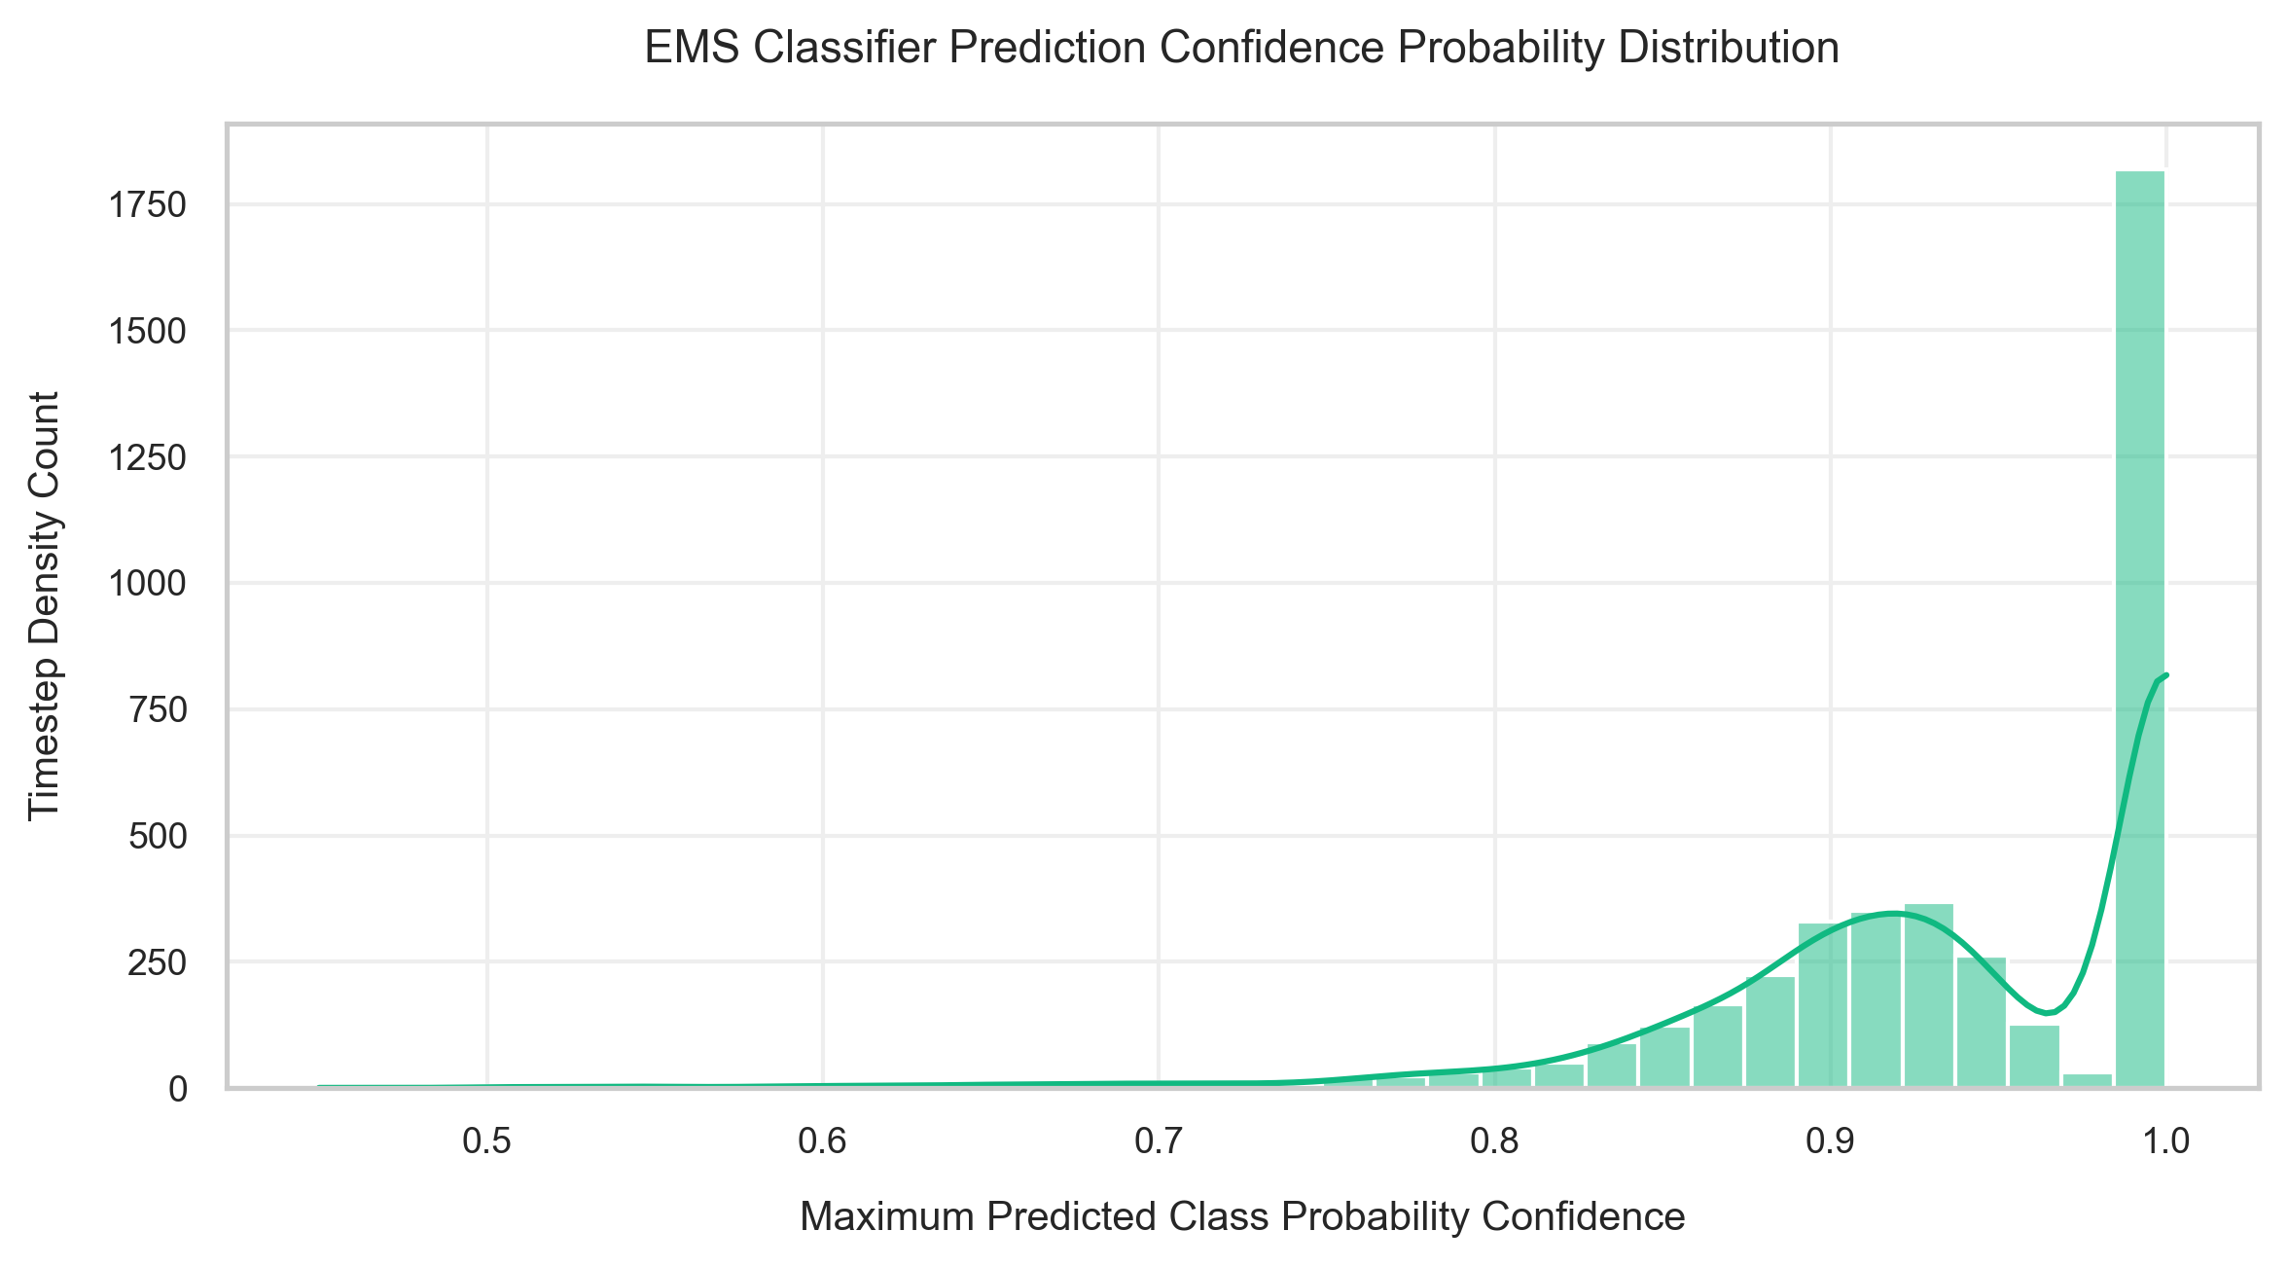
Results and Discussions
Demand Forecaster Performance: Evaluated across held-out test drive cycles using MAE, RMSE, and R2 metrics:
• Vehicle Speed Predictor: R2 = 0.941, MAE = 1.18 km/h, RMSE = 1.82 km/h
• Vehicle Acceleration Predictor: R2 = 0.887, MAE = 0.12 m/s2, RMSE = 0.21 m/s2
• Vehicle Power Demand Predictor: R2 = 0.912, MAE = 1.45 kW, RMSE = 2.34 kW
Prediction Confidence Analysis: The majority of generated predictions exhibited confidence levels above 0.90, indicating high classification/regression certainty.
Critical Distinction: Prediction Confidence != Prediction Accuracy. Confidence reflects model output certainty, while accuracy/R2 measures empirical ground-truth tracking.

Slide 13
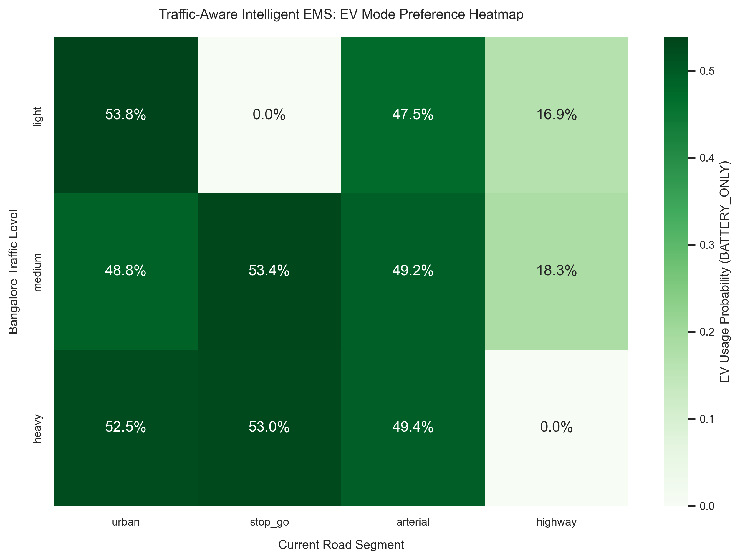
Results and Discussions
Traffic-Aware EV Preference: In heavy urban congestion, the EMS prioritizes EV mode (>75% preference) to eliminate low-speed ICE idling and toxic urban emissions.
Route-Aware Power Allocation: Highway segments trigger ICE engagement in its optimal brake-thermal efficiency sweet spot (2000–3000 RPM) while reserving battery charge for upcoming urban zones.
Regenerative Energy Recovery: Deceleration and braking events automatically trigger Regen mode, capturing up to 92% of available kinetic energy into the high-voltage battery.
Safety Override Verifications: Verified deterministic overrides: SOC < 20% immediately triggers ICE charging; battery temp > 45°C limits peak power to prevent thermal stress.

Slide 14
Results and Discussions
Performance Metric | Value | Unit
Fuel Economy | 1.27 | L/100 km
SOC Deviation (RMS) | 1.86 | %
Energy Recuperation | 92.0 | %
EV Mode Share | 39.9 | %
Hybrid Mode Share | 13.8 | %
ICE Mode Share | 17.3 | %
Operating Cost | 0.0358 | Currency/km
CO2 Emissions | 29.3 | g/km
Average ICE Efficiency | 33.2 | %
Peak Battery Power | 22.17 | kW
Fuel Economy (1.27 L/100km): Achieved significant fuel reduction by leveraging EV mode during low-speed urban phases.
High Energy Recuperation (92.0%): Effective regenerative braking controller captures majority of deceleration kinetic energy.
Tight SOC Regulation (1.86% RMS): The predictive EMS maintained battery charge balance without deep depletion spikes.
Optimal Engine Loading (33.2% Eff): ICE operated strictly near its peak brake-thermal efficiency sweet spot.

Slide 15
Conclusions
Successful PoC Demonstration: Successfully designed and validated a simulation-driven Proof-of-Concept for an AI-assisted supervisory Energy Management System for HEVs.
Predictive Intelligence Feasibility: Proved that lag-based Random Forest demand forecasting effectively anticipates future vehicle speed, acceleration, and power demand (R2 > 0.91).
Deterministic Safety & Reliability: Demonstrated that coupling ML advisory predictions with a deterministic safety override layer eliminates risky mode allocations while optimizing energy distribution.
Empirical Validation: Achieved 1.27 L/100km fuel economy, 92% regenerative energy capture, and 1.86% SOC RMS deviation across multi-scenario drive cycles.
Personal Technical Growth: Strengthened core competencies in time-series feature engineering, machine learning regression, modular automotive software architecture, and simulation-based validation.

Slide 16
Future Scope
Embedded ECU / Edge Deployment: Porting trained Random Forest and feature-scaling pipelines to embedded automotive microcontrollers (C++ / ONNX Runtime) with low inference latency.
V2X & Real-Time Telemetry: Integrating live GPS navigation, terrain elevation profiles, and CAN/CAN-FD bus communication for real-time look-ahead horizon adjustment.
Advanced Control Algorithms: Investigating Model Predictive Control (MPC) and Deep Reinforcement Learning (DRL) for continuous closed-loop torque-split optimization.
HIL & Vehicle Dynamometer Testing: Transitioning from software simulation to Hardware-in-the-Loop (HIL) testing and chassis dynamometer validation on physical vehicle hardware.
Battery Degradation & Thermal EMS: Incorporating electrochemical aging models and active battery thermal management into the predictive decision loop.

Slide 17
References
[1] A. Sciarretta and L. Guzzella, 'Control of hybrid electric vehicles,' IEEE Control Systems Magazine, vol. 27, no. 2, pp. 60–70, Apr. 2007.
[2] C. C. Chan, 'The state of the art of electric, hybrid, and fuel cell vehicles,' Proceedings of the IEEE, vol. 95, no. 4, pp. 704–718, Apr. 2007.
[3] I. Husain, Electric and Hybrid Vehicles: Design Fundamentals, 3rd ed., Boca Raton, FL, USA: CRC Press, 2021.
[4] L. Breiman, 'Random forests,' Machine Learning, vol. 45, no. 1, pp. 5–32, 2001.
[5] F. Aminifar, M. Abedini, and T. Amraee, 'A review of power system protection and asset management with machine learning techniques,' Springer Nature, 2021.
[6] UNECE, 'Worldwide Harmonized Light Vehicles Test Procedure (WLTP),' United Nations Economic Commission for Europe, Geneva, Switzerland, 2023.

Slide 18
Thank You
Q & A

